Slide 1
Preliminary Engineering Advisory Board Senior Project Review Knights of Columbus website
Brandon Essary, Sunya Chay, William Flores

Slide 2
Roles and responsibilities
Responsibilities
All members are responsible to communicate with each other. The best teams will fail if there is poor or no commutation.
When presenting a roadblock team members should present options to get past the problem or be open to solicitation form other teammates.
Any team member should be ready to fill the role of another if that person is unavailable .
Roles
Brandon Essary (Team lead) Brandon is responsible for contact with the customer and setting up meetings. Research and coding.
Sunya Chay (Team member) Research, coding and web design.
William Flores (Team member) Research, ADA requirements, coding.

Slide 3
Introductions
Team Introductions
Project name: kofc-wa.org website update
Project client: Dr. Olwell- Knights of Columbus Washington state council

Slide 4
Purpose of the project
The purpose of this project is to update the current Knights of Columbus Washington website to provide the client and end user a secure website that is sleek and easy to use. With this project we will provide a website that is easy to navigate for both the end user and the website administrator. The end state for this project is for the elected members to be able to communicate in mass with current and future members about past, current and future events in real time.

Slide 5
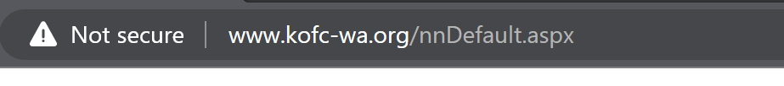
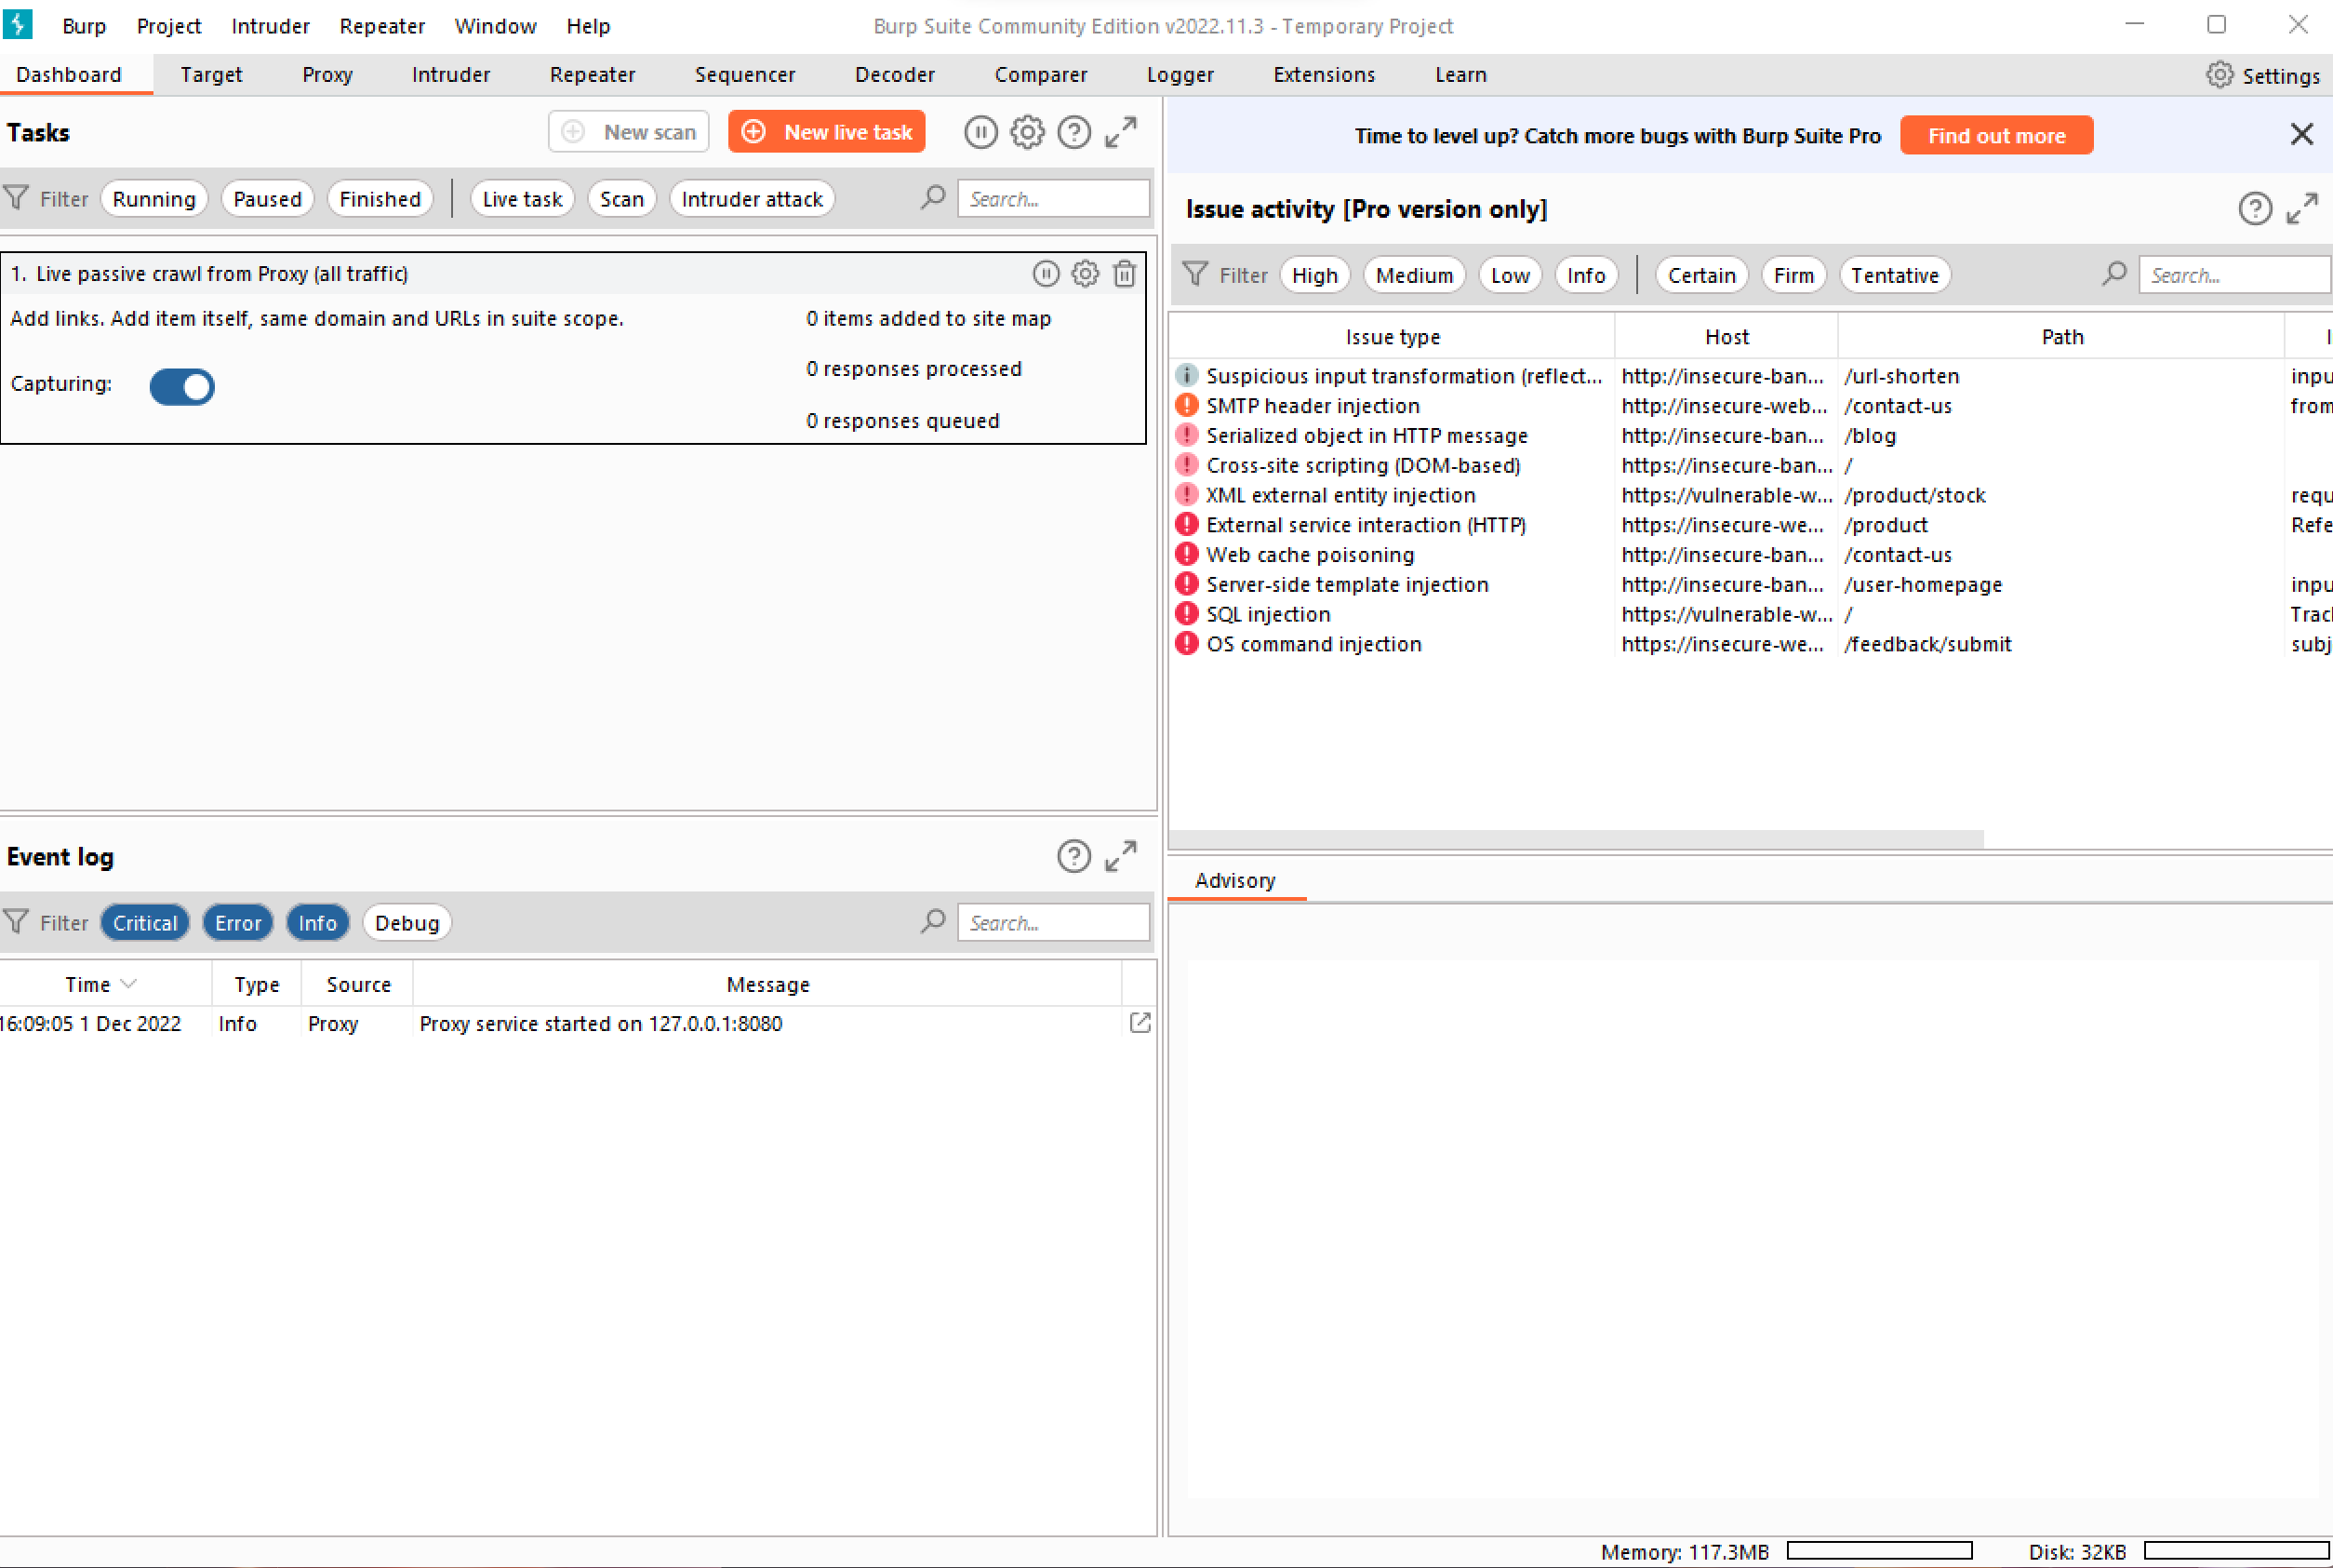
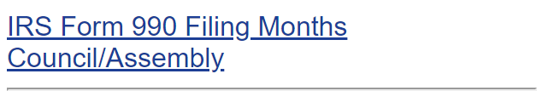
Current state of http://www.kofc-wa.org/
The current site is not secure.
The site is does have personal identifiable information leaks in more than one location.
The site is not used to pass information, not updated or used to full potential.
The current site is prime to hackers via SQL injection (Burp Suite) or other means.

Slide 6
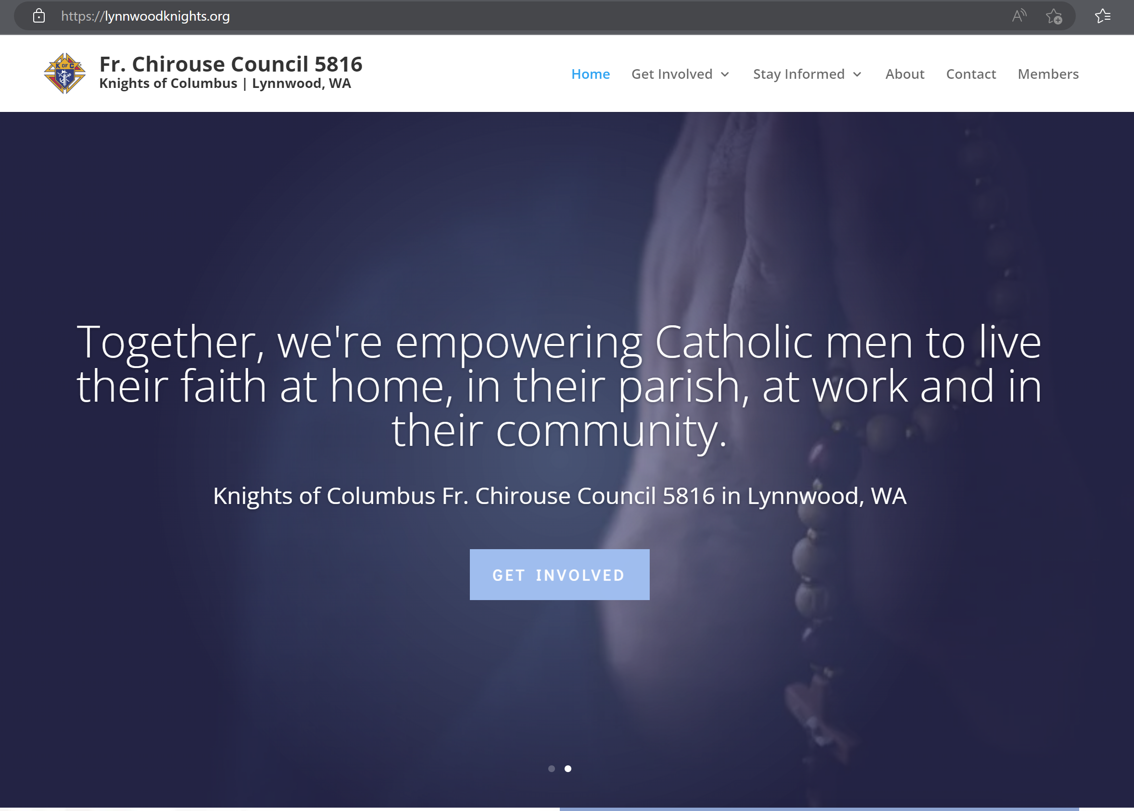
Motivation for the new site. (lynnwoodknightsofcolumbus.org)
User can quickly figure out the who and what the Knights of Columbus are.
The site is secure.
Easy to navigate site.
Can reach wanted information either on main page or within a few clicks.
Overall sleek and stunning web design.

Slide 7
Our current plan
Backend will run on ASP.NET with Microsoft SQL server 2019. This program will run on a webhost.
Our design will focus on three types of users. Those who are looking for information on the Knights of Columbus (restricted), users that are members of the Knights of Columbus (login required), users that can make changes to the site (unrestricted) add items, delete items, and search for items (photos, documents, and events calendar) .

Slide 8
Technical/qualitative project constraints
Access to data restricted to members only.
ADA requirements for websites. Our goal for the new website is to be compliant to the checklist level AA at launch.
Having to learn webhost control panel to maximize website for the end user.
If decided not to start with a webhost, ensuring that current prototype can be passed to and from team members so as the project is moving forward.
Unknown budget requirements with AWS.

Slide 9
Risk
Cost: Website hosting is currently covered by overall budget. There is no risk with running over budget.
Schedule: Currently the team is on schedule, with a few exception as outlined in the schedule the team has not met with Knights of Columbus state board.
Compliances: Using best practices for securing the website will come from coding the website and encrypting the database. At the prototype phase the site will follow ADA requirements level AA.
Site performance: The current site is hosted with a webhost site however our goal is to move to webhost that will provide overall better performance and security.
Additional requirements: As the project moves forward, add functions will slow production.

Slide 10
Current Schedule
Date | Event | Notes
December 6th, 2022 | Presentation Due to YouTube | -Also need to email every link to Tam Leger and Prof. Nelson
December 9th, 2022 | Final Written and Oral Presentation Due
February 17th, 2023 | Poster 1 Due
February 20th, 2023 | Front end completed | Homepage with links to other pages
February 27th, 2023 | Login pages completed
March 13th, 2023 | Security completed | Making sure that the website is secure
March 16th, 2023 | Meeting with Members to approve the website
March 20th, 2023 | Finalize prototype and set up in host system | Placing prototype into server like AWS or Azure
March 27th, 2023 | Launch Prototype and Finish and Record Presentation
April 6th, 2023 | Submit Presentation and All Links
Date | Event | Notes
October 10th, 2022 | First Meeting
October 31st, 2022 | Schedule, ADA Requirements, Use Cases for Meeting Due
November 7th, 2022 | List of Requirements Completed and Ready for Approval | Needs to also include, budget, restraints and risks
November 10th, 2022 | Meeting with Members to Approve List of Requirements
November 14th, 2022 | Mock-up of website
November 17th, 2022 | Meeting with Members to Approve the Mock-up
November 21st, 2022 | Presentation, and Video Needs to be done and recorded

Slide 11
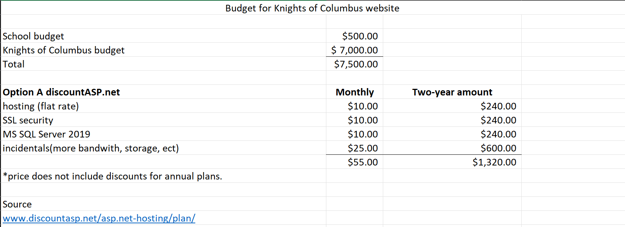
Budget option A (discountasp.net)
Pros
Great for small websites.
Current webhost for site
Cons
Can get expensive quickly.
Webhost is metered where another webhost are not.
Exceeds the school budget.
Notes:
If we were to pay annually for webhost there could be included discounts of around 25%.

Slide 12
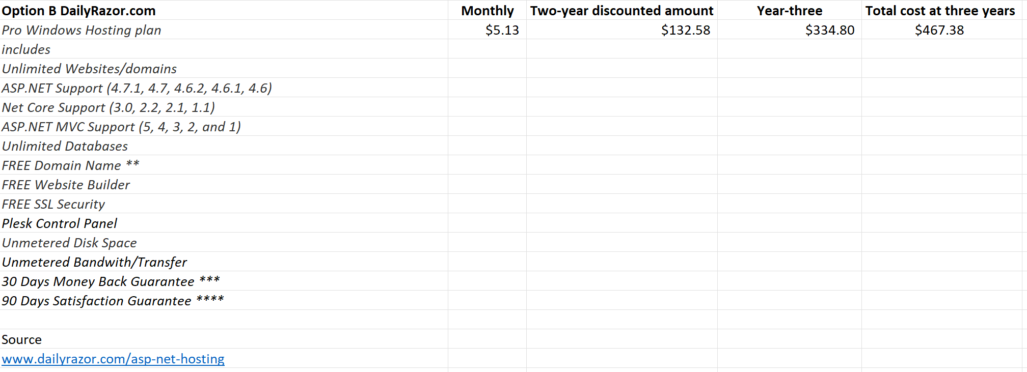
Budget option B (dailyrazor.com)
Pros
Much cheaper that current webhost.
Added value with long term commitment.
At three years inside the school budget.
Cons
May not be able have access to desired database.
Customer service will be limited to email and live support.
Notes:
With contract discounts are about 65%.

Slide 13
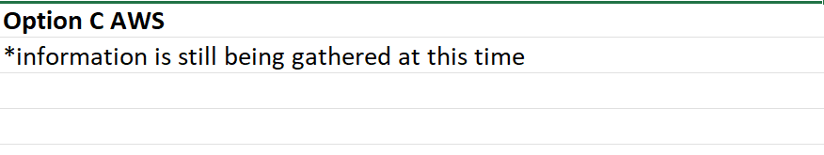
Budget option C (AWS)
Pros
World class customer service.
Cons
No known cost currently.

Slide 14
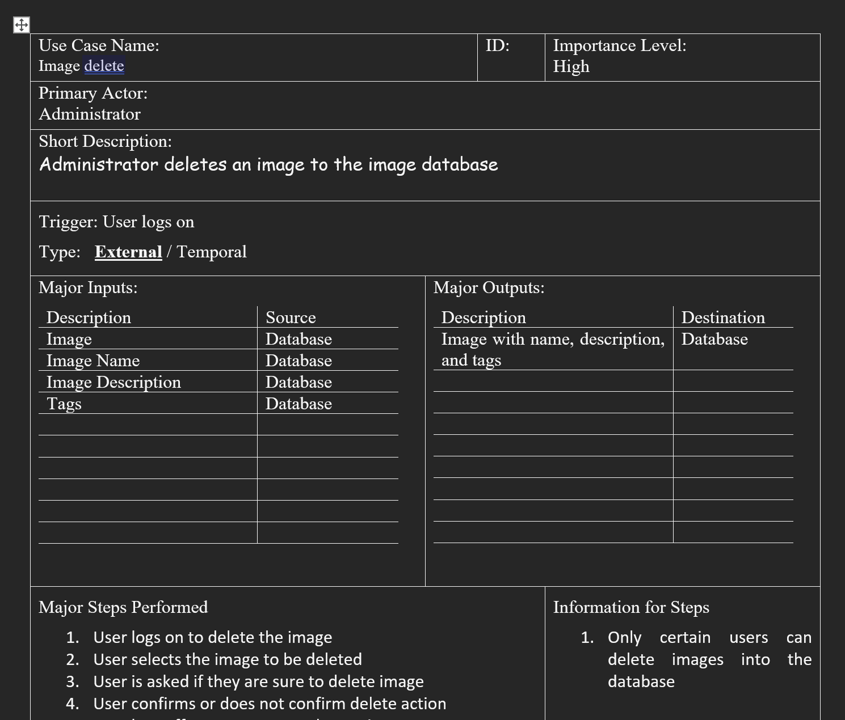
Progress
Use cases for document repository, calendar of events, and photo gallery (search, upload and delete).
Budget and schedule for project.
ERB for the database.
A mock-up of what the site could look like.
In contact with AWS concerning hosting options.
Notes:
Currently we in contact with ASW customer support. AWS customer support is reaching out to Account Managers to best move forward.

Slide 15
Next Steps
Looking to the state council for approval of the project. This is not limited to the layout of the site; the group will need approval for all aspects of the website to include the look and contents of the website.
Decide the web provider to host the site.
Get to coding the site.
Notes:
Thank you for your time. This concludes our presentation. If you have any questions please feel free to contact brandon, SC or myself. Have a great day!

